Slide 1
Storyboard for Ortho Game
(images used in this presentation are for example only. These will not be used in our game)

Slide 2
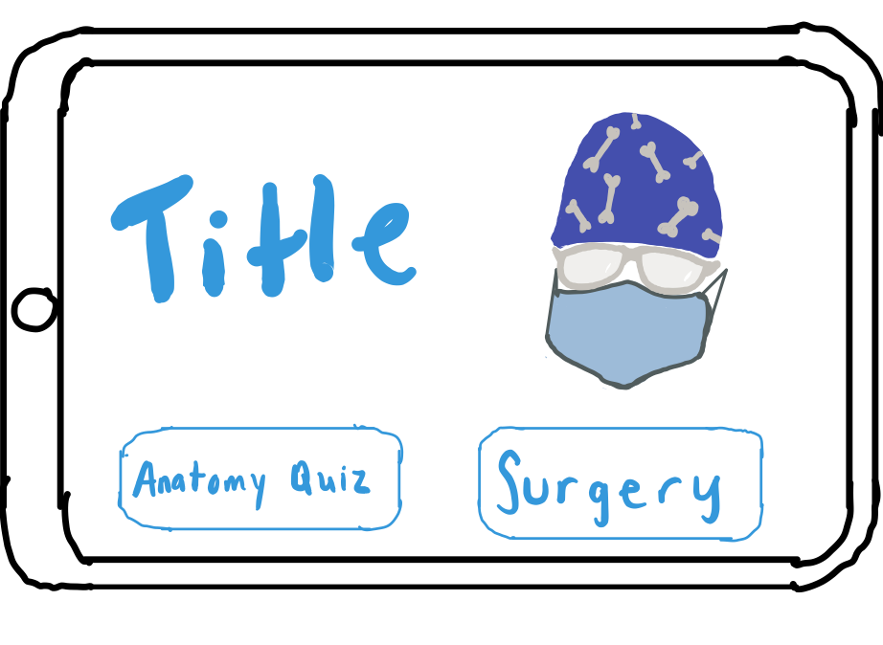
Home Screen
Anatomy quiz starts on game launch but has an option to skip
Play Scenario Mode
Title of the game
Some image or graphic can go here too, as well as a mention to Penn State Hershey

Slide 3
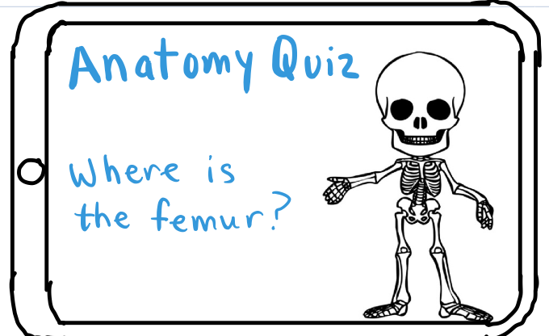
Anatomy Review Game
Name of 1 bone comes up and user must select it. If incorrect, correct bone is highlighted
Must play Anatomy Review first time playing game
Plays through all of the bones we want user to identify
No required score

Slide 4
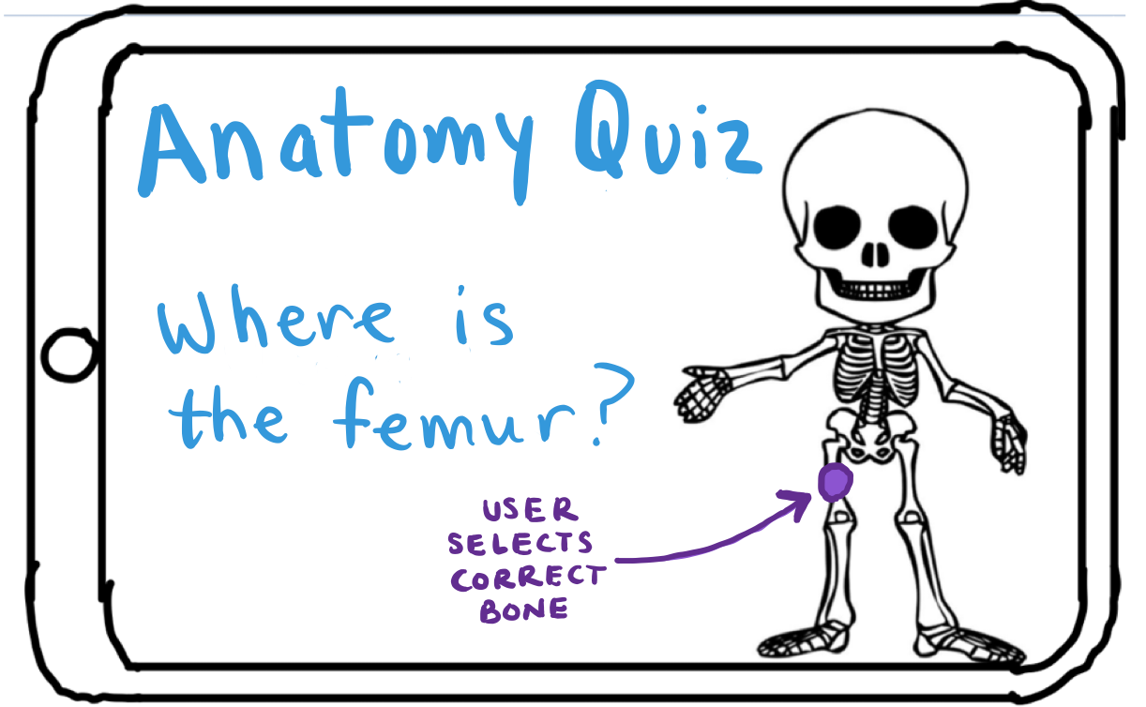
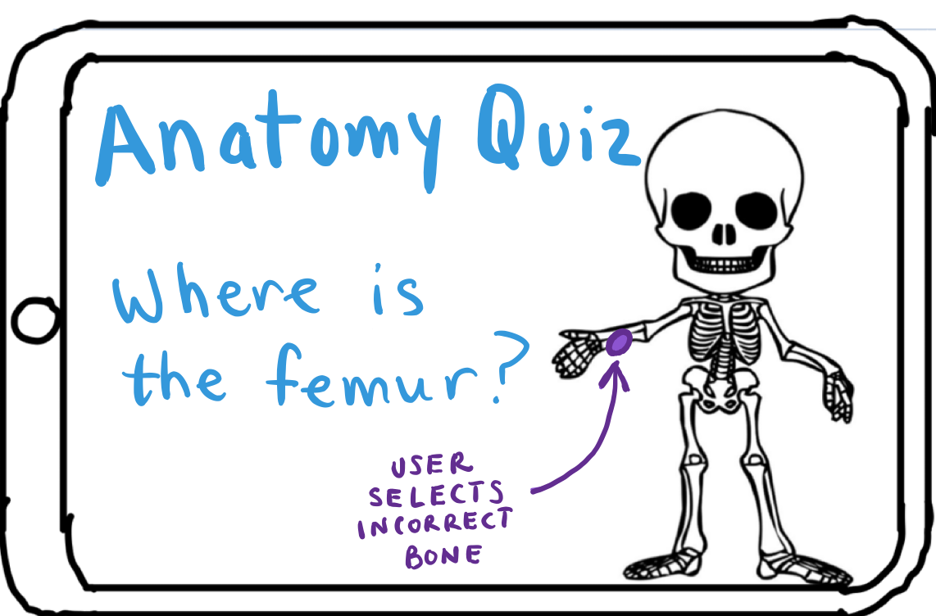
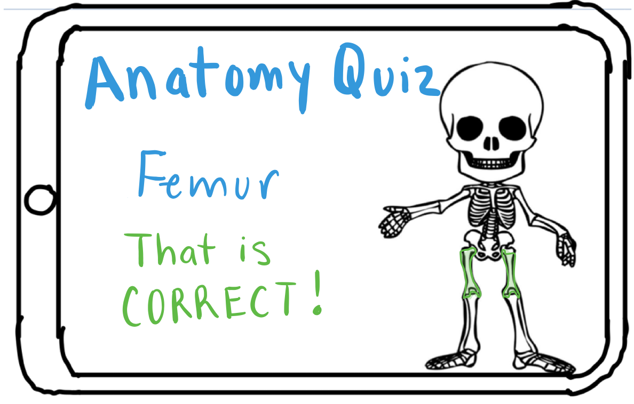
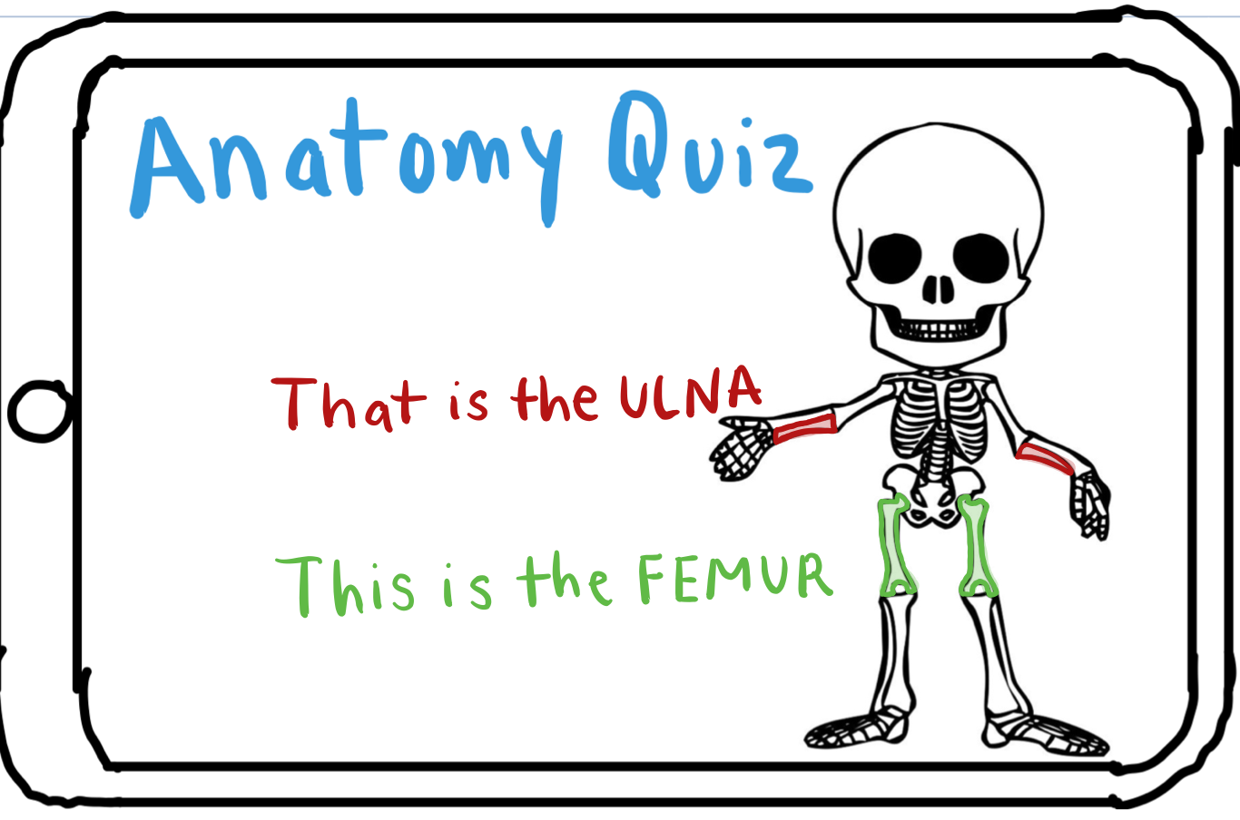

Slide 5
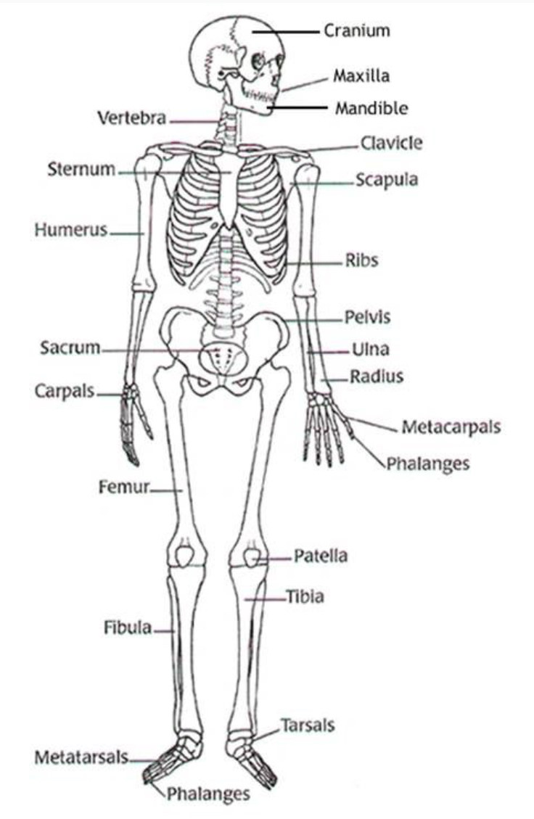
Appropriate Level of Detail for Anatomy
This is a reference of which bones we expect a high school student to know. Do you wish to see more, less, or do you agree with this?
Differentiating the different bones in the hands and feet, or other concentrated areas, would be nearly impossible on a cell phone screen. Right now, we aren’t planning on implementing a zoom feature for this part, so if we ask the user to find the phalanges, we are thinking any fingers or toes would be the right answer, and then they would all be highlighted.

Slide 6
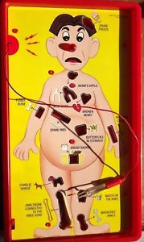
Identifying the Anatomy
Based on visible trauma
Based on patient complaints
2 different scenarios for now
Will be one of 8 possible locations on the body

Slide 7
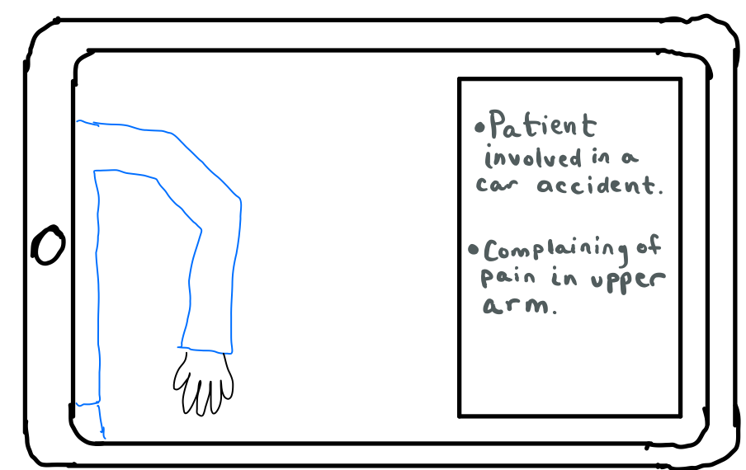
Inform player of scenario
We will keep this simpler for now (as a brief that the player reads) in order to focus on completing the anatomy and surgical portions of the game, and then make this more interactive if time permits.

Slide 8
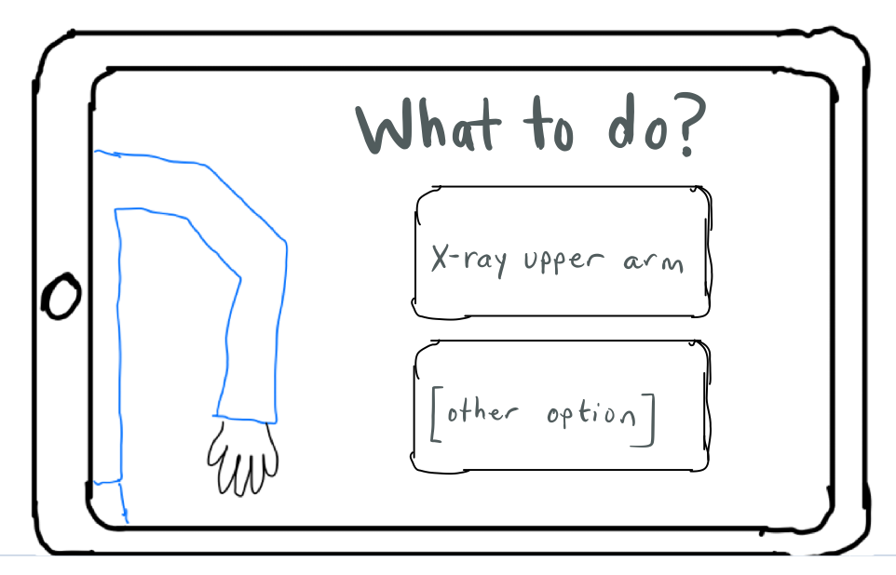
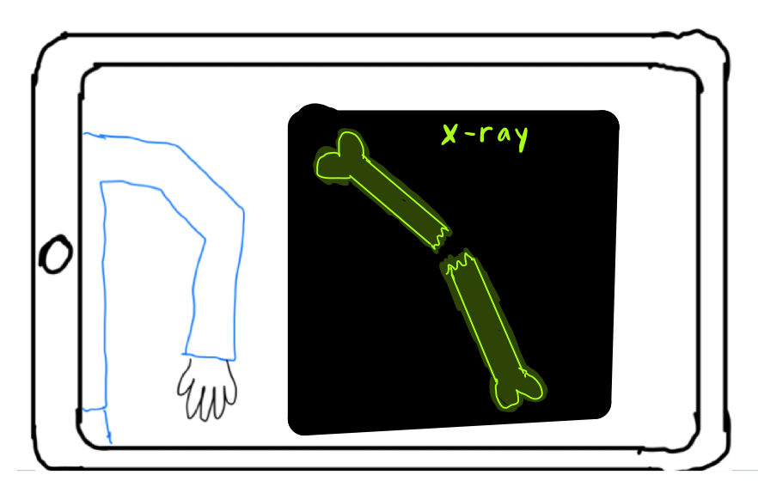
Analyzing the severity of the injury
Checking x-rays to see if the bone is broken, ligament is torn, etc.

Slide 9
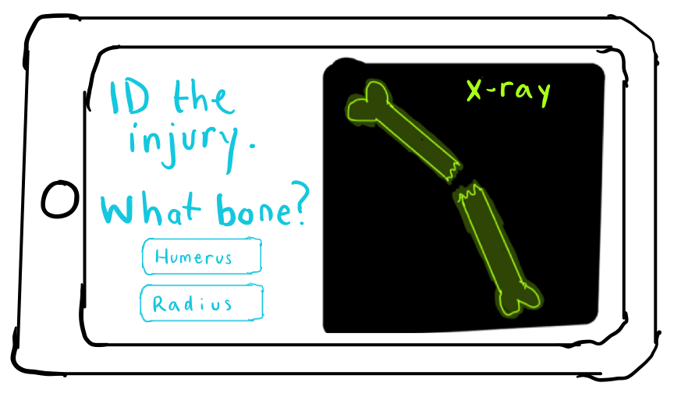
Choose what to fix and how
Decide the procedure based on the type of injury
Ex: choose the right plates and screws and place them on the bone correctly

Slide 10
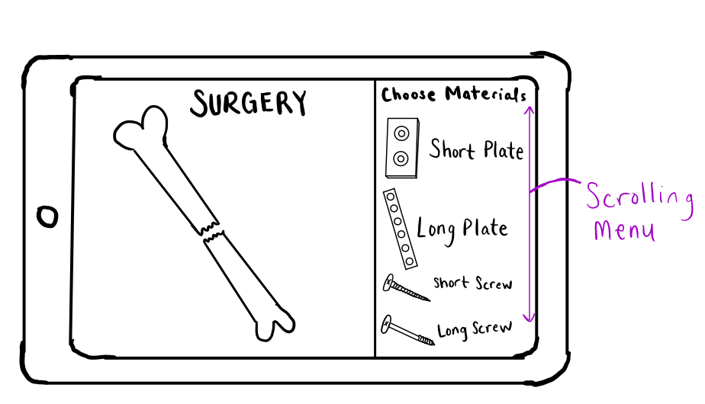
Display Materials

Slide 11
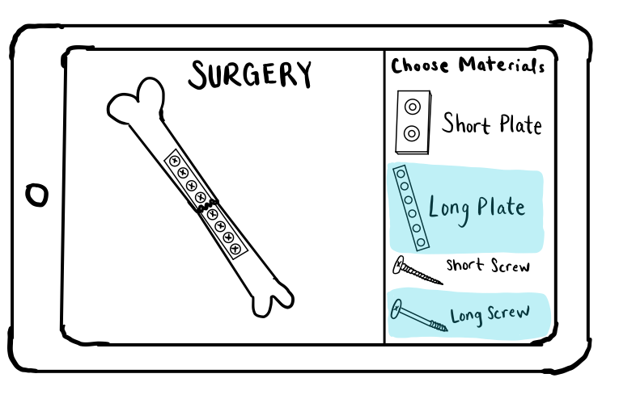
Choose Materials
User selects which materials to use
For now, we will have the materials appear in the location once the user selects them. We will make it a “drag and drop” if possible.
Sponsors: should the materials have simple names like this or be more accurate, like Herbert Screw?

Slide 12

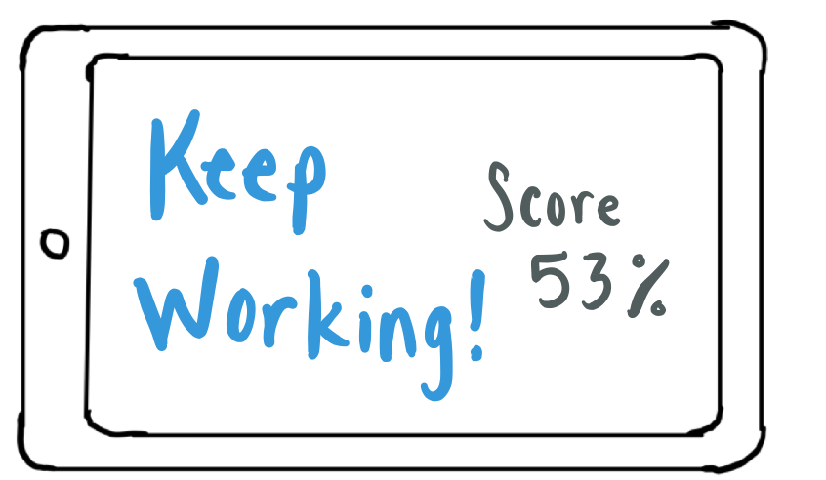
Show evaluation
Show whether or not the choices for plates and screws was correct, gives feedback for correct or incorrect choices.
Maybe something like “used wrong size plate, which caused further damage to the bone”

Slide 13
Our questions for sponsor team
What scenarios would be good to use?
How detailed does the anatomy quiz need to be?
What steps would go into the procedures and what would some possible mistakes be that make sense? For example, choosing a plate that is size x rather than size y, or taking an x-ray of the area rather than… amputating a toe? What are reasonable extremes for the choices the player will make? What would a “cliffs notes” or “orthopaedic surgery for dummies” version be?
Can you send us pictures of the plates and screws or send us a link to a good website for that? We have found some med school websites and orthopaedics journals, but there is a lot of information out there, so it would help to know from you that what we are using for reference is valid, accurate, and in line with your expectations.
Any ideas for a name for the game? And a logo? It will be what the user clicks on on their phone to open the app, the first image they see in the App Store, so it’s an important first impression! Also, do we need to mention any affiliation with Penn State/Hershey Medical?

